Slide 1

E Library: Explore the Virtual Bookstore
Welcome to E Library, the virtual bookstore revolutionizing the way we read. Discover the convenience and endless possibilities of e-books in our immersive digital platform.

Slide 2

The Importance of E-books and Virtual Bookstores
In a world embracing digital transformation, e-books and virtual bookstores have become an essential part of our reading culture. Explore how this shift is shaping the way we access and enjoy literature.

Slide 3

Benefits of Virtual Bookstores
Convenience 📚
Cost-Effective 💰
Environmental Friendly ♻️
Access millions of books anytime, anywhere, without the need for physical storage space.
Save money on shipping and printing costs with instant digital downloads.
Reduce paper consumption and carbon footprint by opting for e-books.

Slide 4

Features of E Library Virtual Bookstore
Personalized book recommendations based on your reading preferences.
User-friendly interface for seamless browsing and book exploration.
Bookmarking and highlighting functionality for easy note-taking.
Integrated book reviews and rating to aid in your book selection.

Slide 5
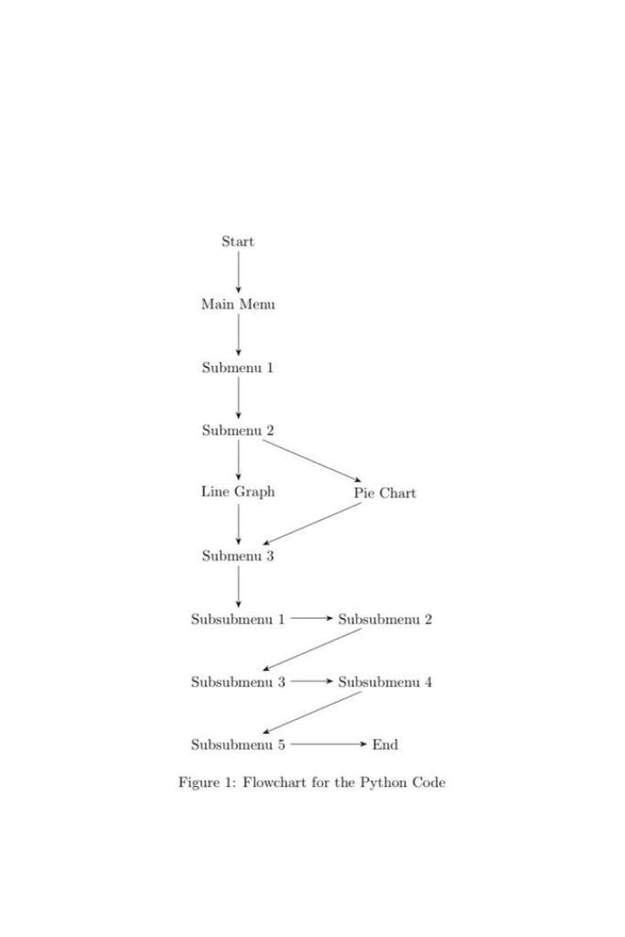
METHODOLOGY
In its most common sense, methodology is the study of research methods. However, the term can also refer to the methods themselves or to the philosophical discussion of associated background assumptions.

Slide 6

How to Access and Navigate the Virtual Bookstore
1
Download the App 📱
Access the virtual bookstore through our mobile app, available on iOS and Android.
2
Create an Account 📝
Sign up to personalize your reading experience and explore exclusive content.
3
Intuitive Navigation 🧭
Easily navigate through genres, categories, and your personal library with our intuitive interface.

Slide 7



Available Genres and Book Categories
Mystery & Thriller
Fantasy & Science Fiction
Romance & Relationships
Delve into suspenseful narratives and solve thrilling mysteries from renowned authors.
Embark on epic adventures, explore imaginative worlds, and push the boundaries of reality.
Indulge in heartwarming love stories and captivating tales of human connections.

Slide 8

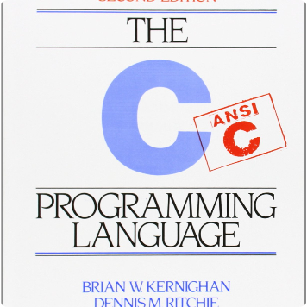


Available Important Book For Coding
C PROGRAMMING
PYTHON
JAVA SCRIPT
c is a general-purpose computer programming language. It was created in the 1970s by Dennis Ritchie, and remains very widely used and influential. By design, C's features cleanly reflect the capabilities of the targeted CPUs.
Python is an interpreted, object-oriented, high-level programming language with dynamic semantics developed by Guido van Rossum. It was originally released in 1991. Designed to be easy as well as fun, the name "Python" is a nod to the British comedy group Monty Python.
JavaScript is a scripting language that enables you to create dynamically updating content, control multimedia, animate images, and pretty much everything else. (Okay, not everything, but it is amazing what you can achieve with a few lines of JavaScript code.)

Slide 9
Virtual Shopping Experience
1
Browsing 🕵️‍♀️
Explore curated collections, browse bestsellers, and discover hidden gems with ease.
Searching 🔍
2
Effortlessly find your desired books using search filters and personalized recommendations.
3
Reading Samples 📖
Immerse yourself in captivating previews to decide on your next page-turner.

Slide 10

The Future of E-books and Virtual Bookstores
With technological advancements and increasing demand, e-books and virtual bookstores are becoming the new norm. Witness the transformation of the literary landscape and embrace the endless possibilities that lie ahead.

